Slide 1


Slide 2
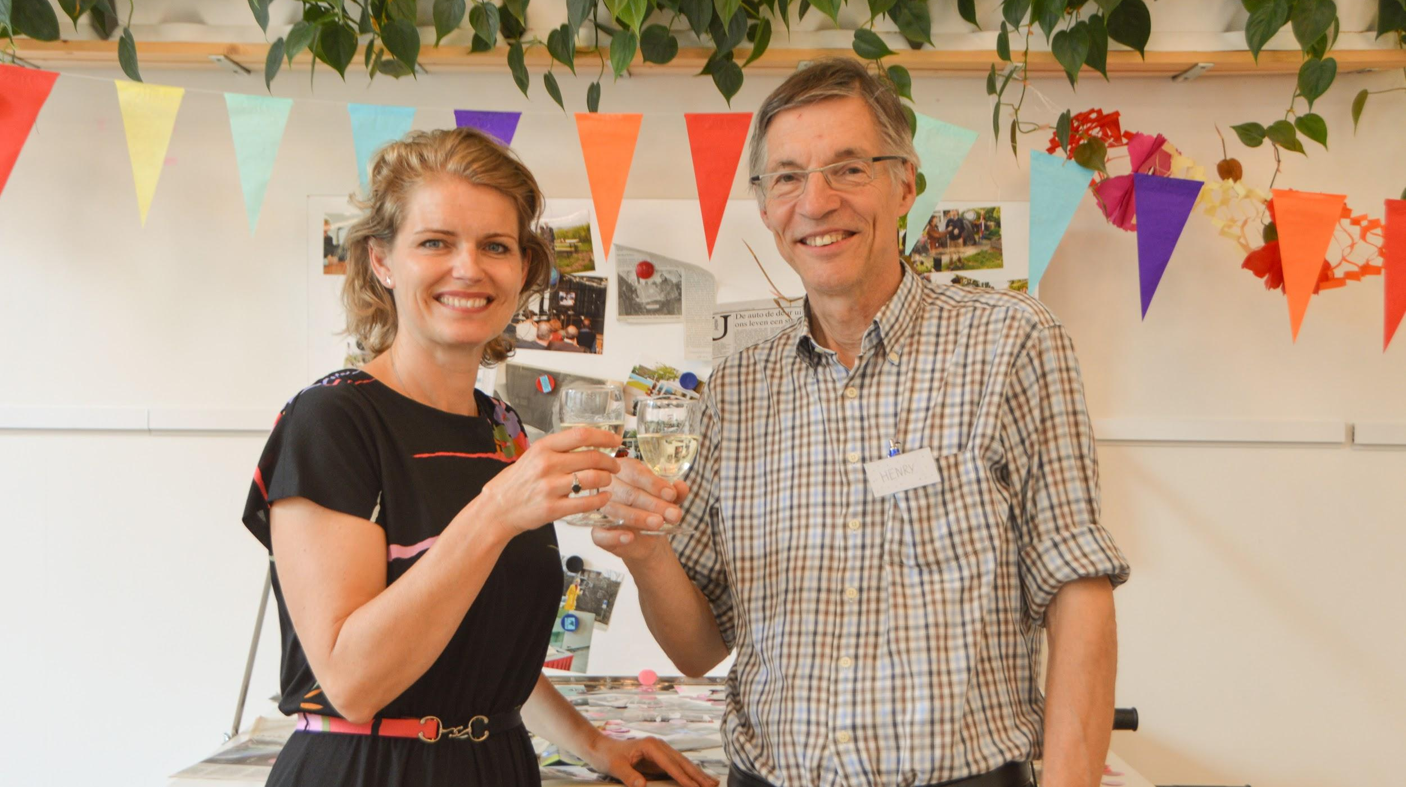

Slide 3


Slide 4


Slide 5
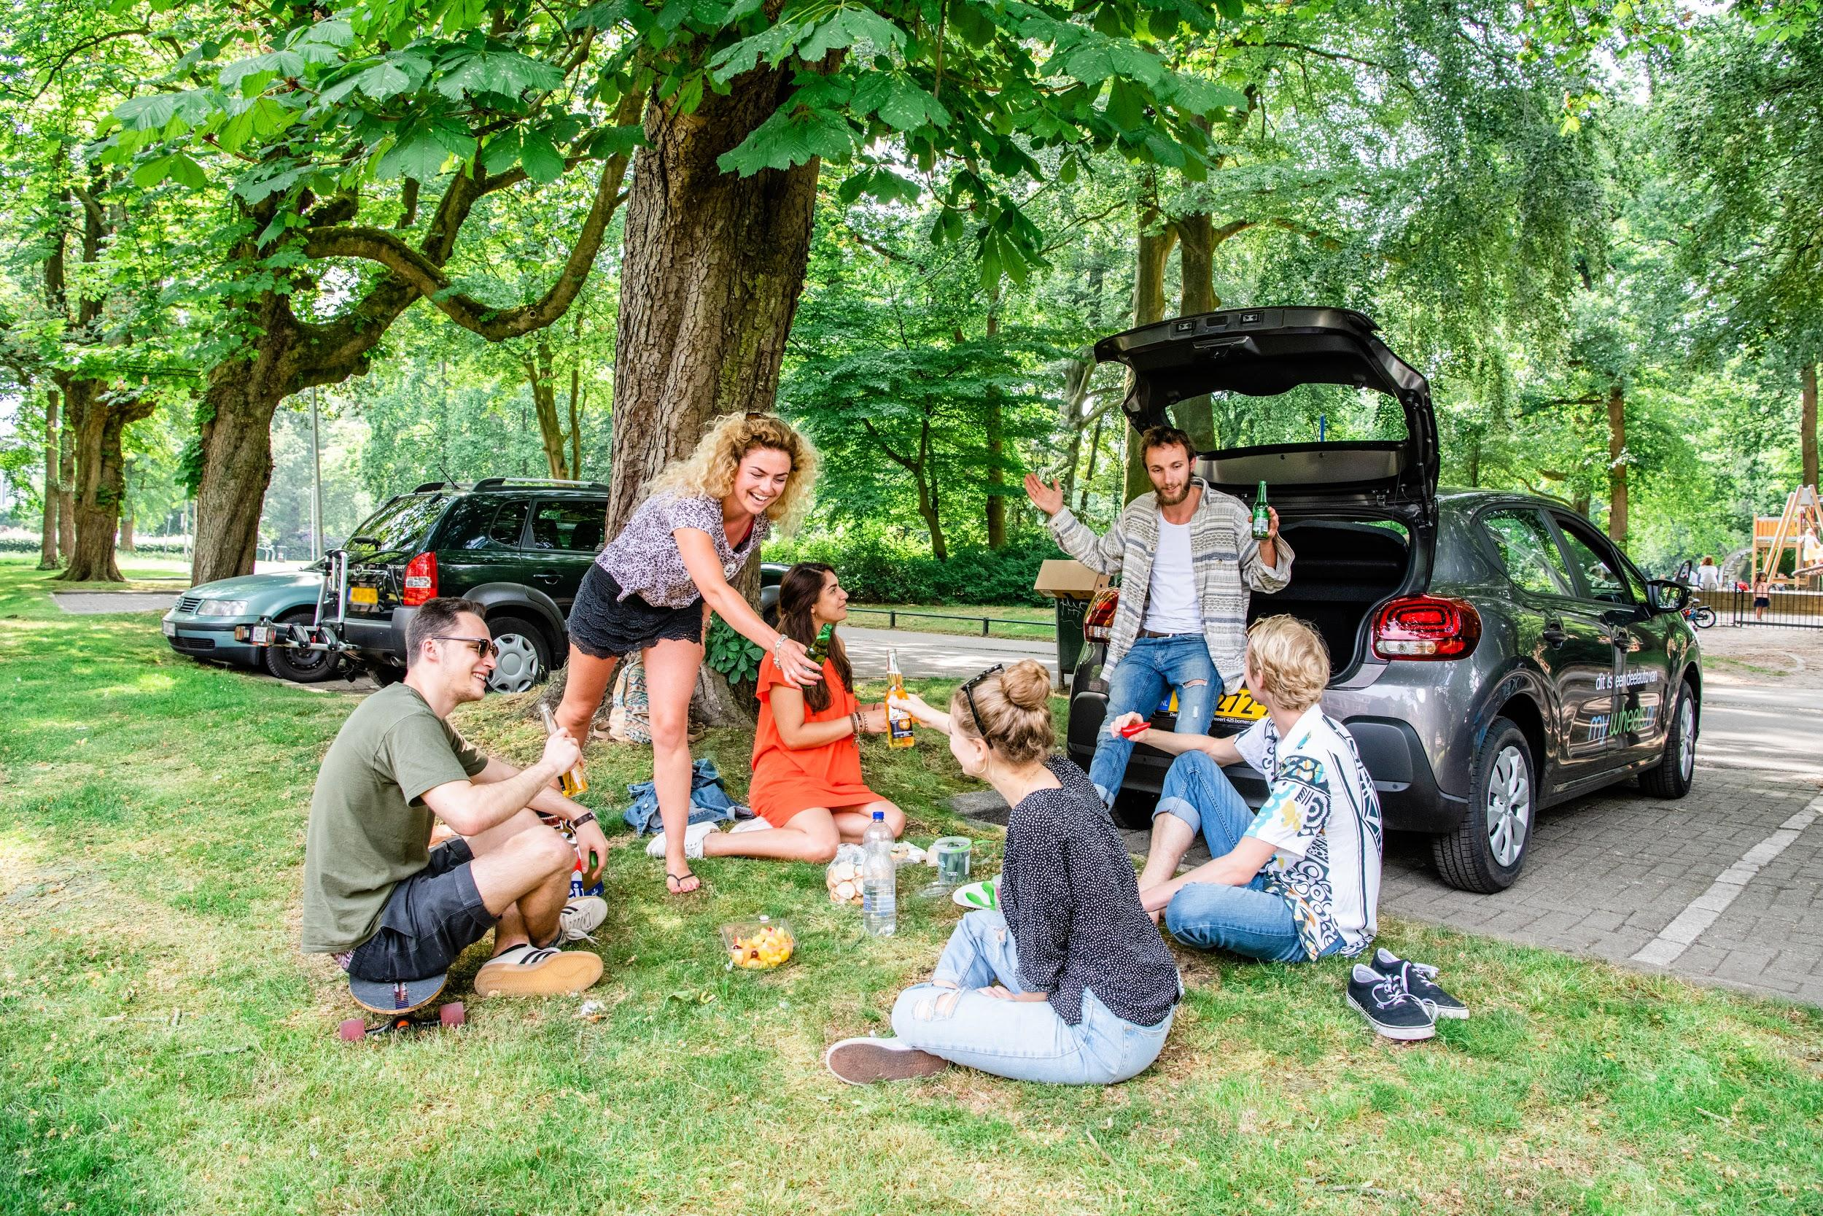
Notes:
Foto Rudy en Alicia

Slide 6
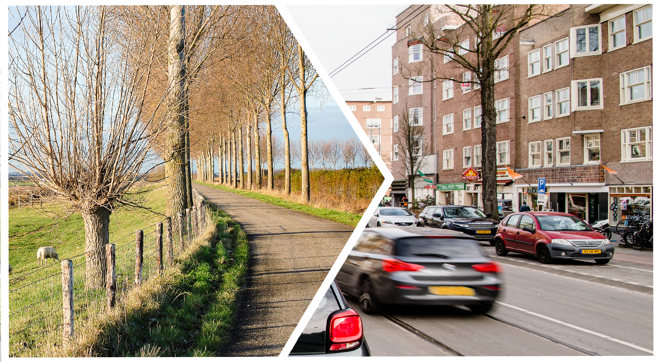

Slide 7


Slide 8


Slide 9
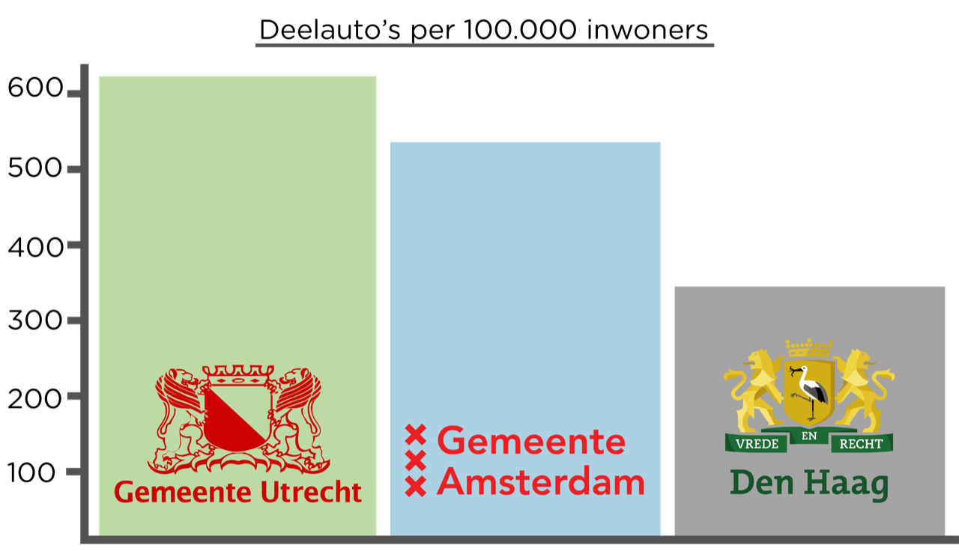

Slide 10
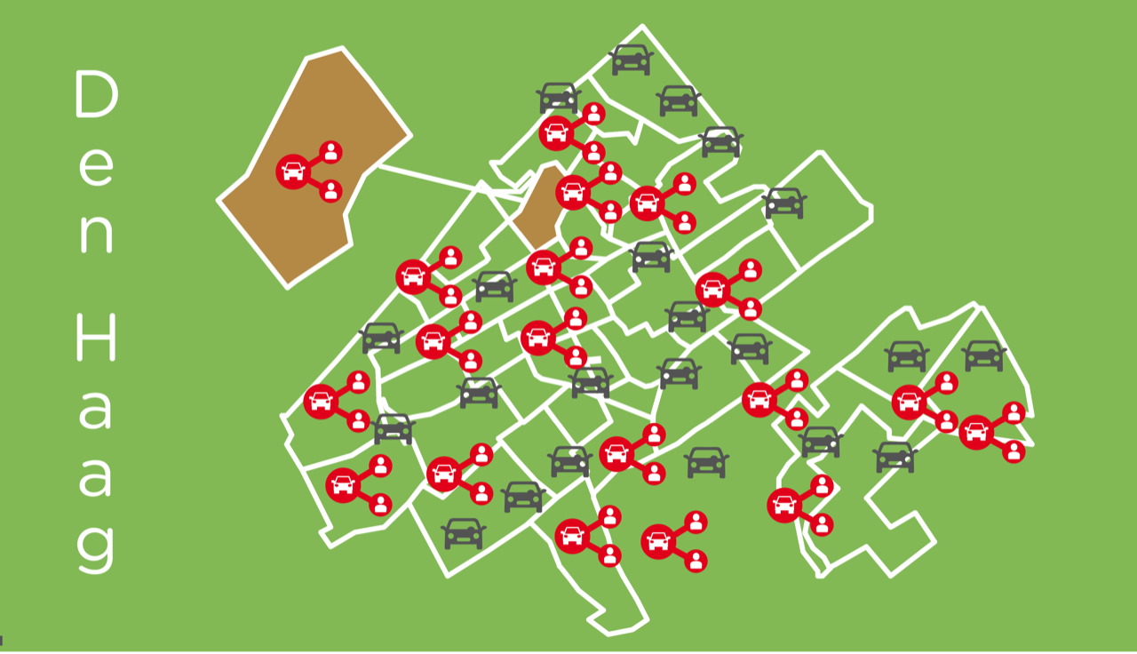

Slide 11


Slide 12
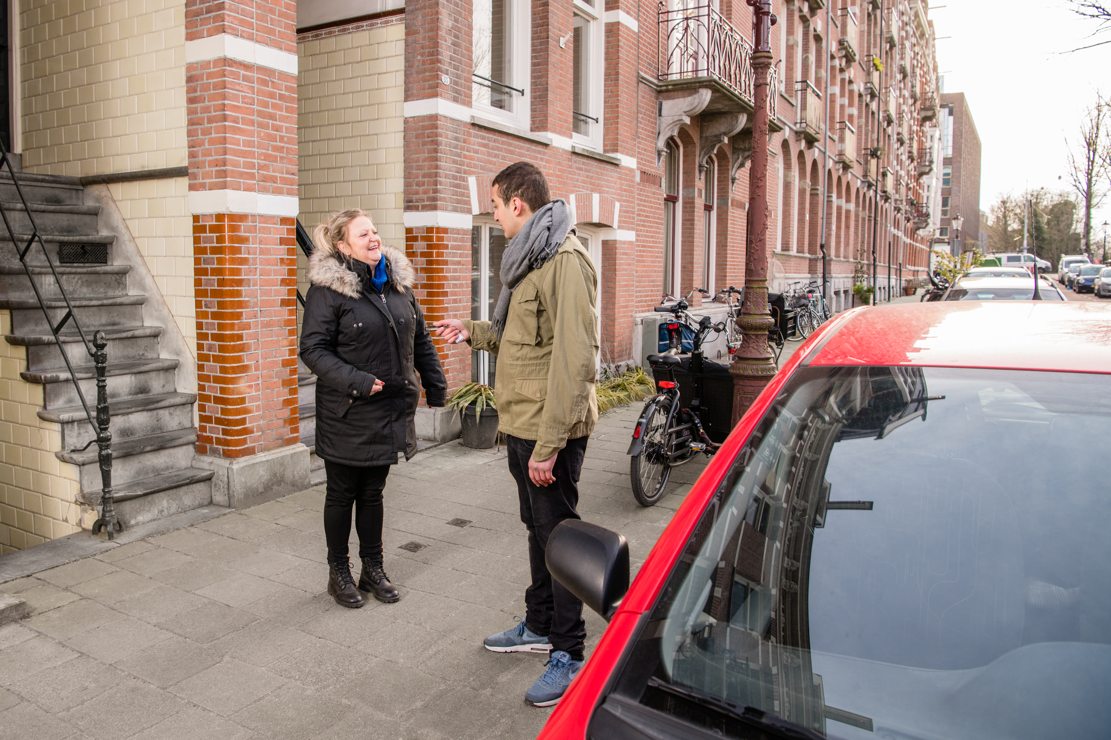
Notes:
people have to see a shared car

Slide 13


Slide 14
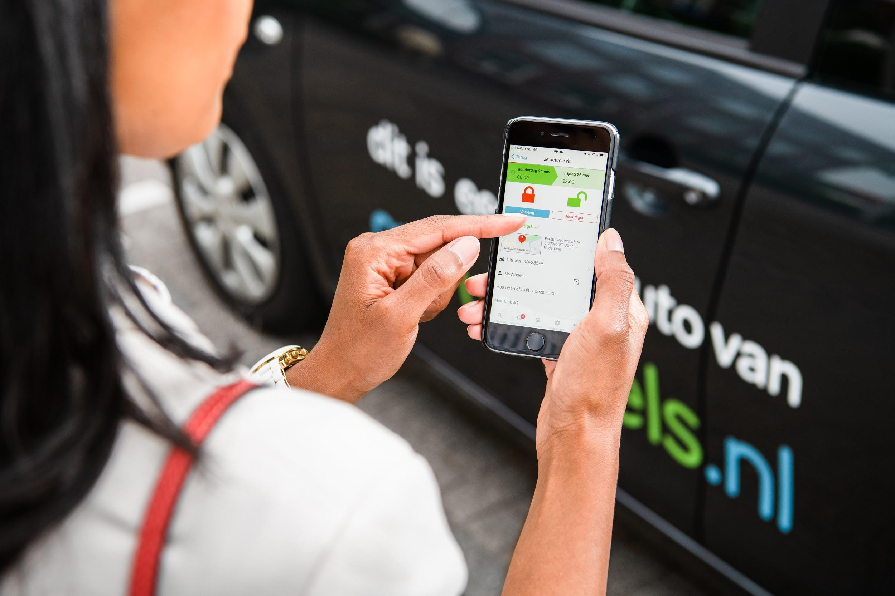

Slide 15
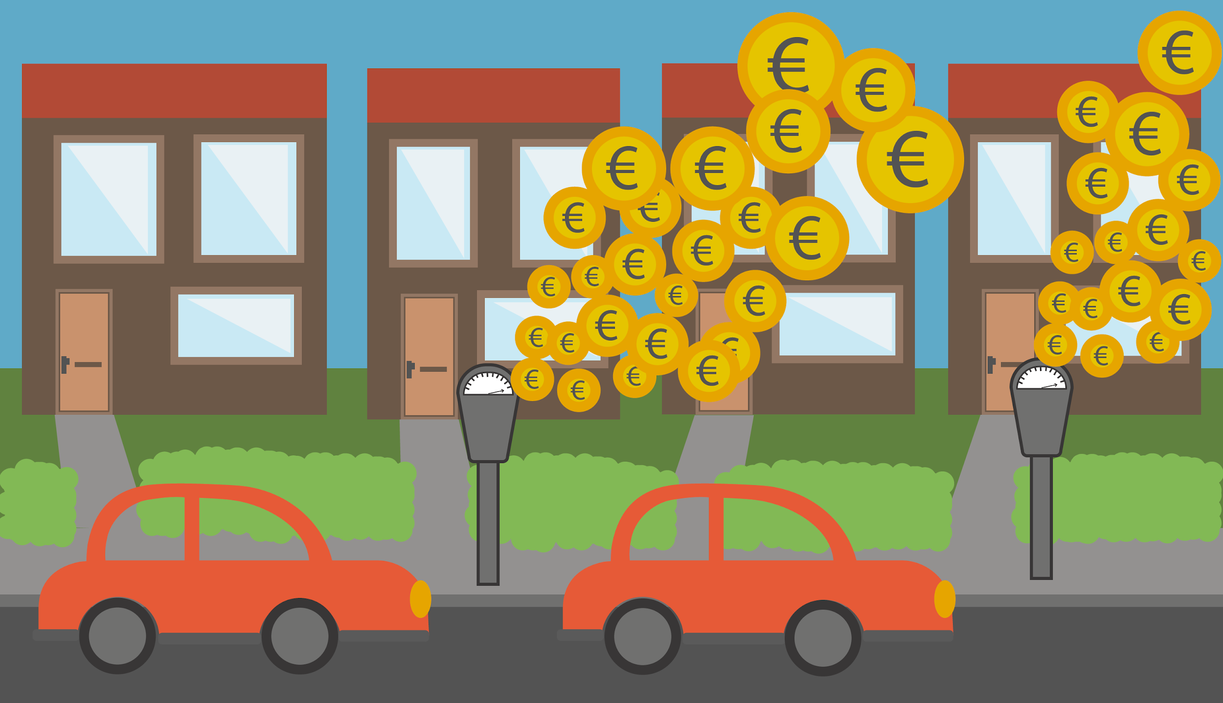

Slide 16
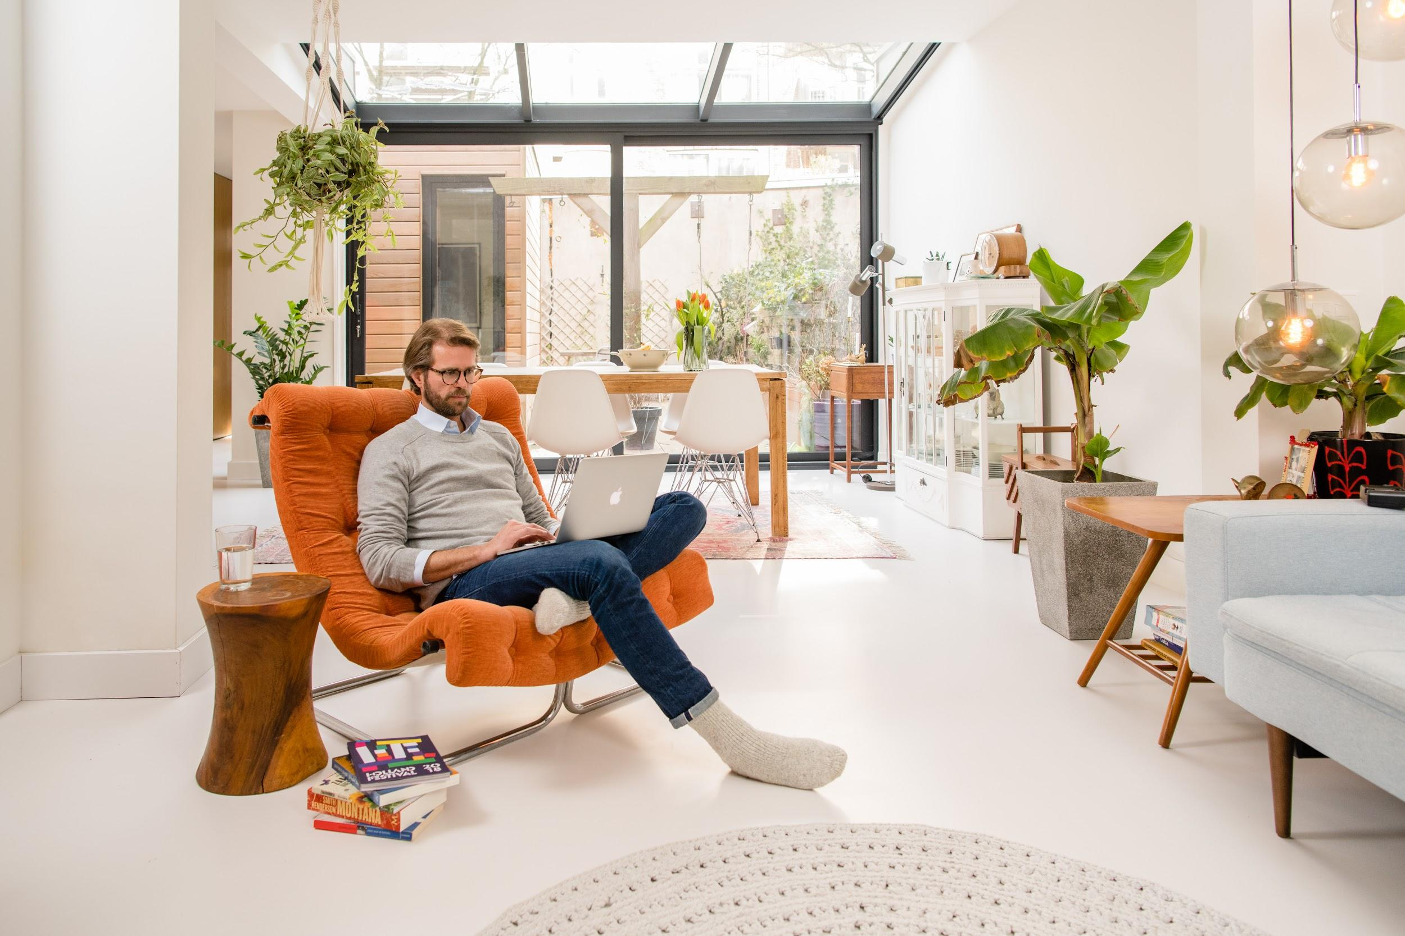
Notes:
Familie Gerritsen foto

Slide 17


Slide 19
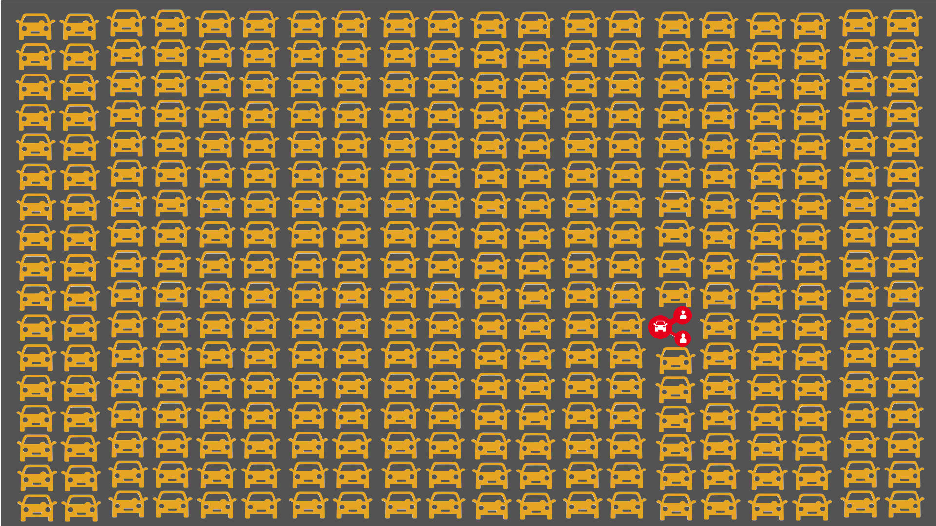

Slide 20
